Slide 1


Population Research Center (PRC)
UPDATE: Towards a better understanding of the ongoing
decline in the birth rate in Switzerland
    Dr. Anthony Hauser, Prof. Dr. Kaspar Staub
    (together with Prof. Dr. Katja Rost, PD Dr. Tilo Burkhard and others)
    15 June 2026
Notes:
Thank you very much for giving us the opportunity to provide a brief update today on our Seed Grant project regarding the declining birth rate in Switzerland.
I am doing this together with Katja Rost and Tilo Burkhard, who are co-project leaders but are not present today. Tilo has since left the University Hospital of Zurich.
And above all, I am doing this together with Anthony Hauser, whom I was able to employ part-time on this project for four months at the beginning of this year.

Slide 2
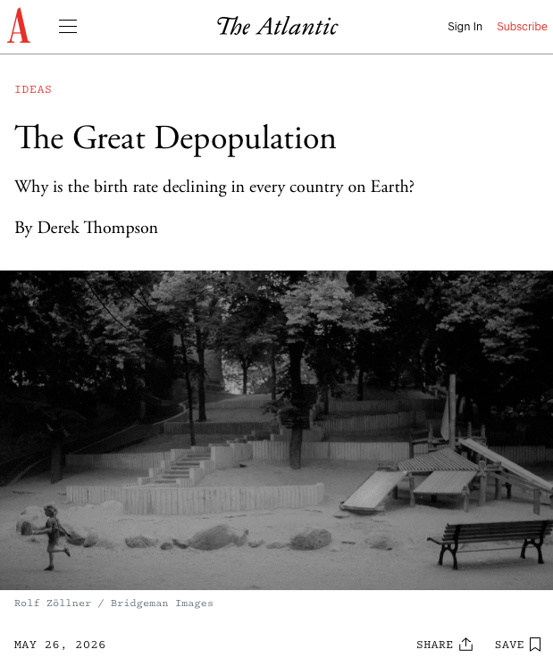
La sous-natalité: un problème global et actuel dans les média
2023: première fois que l’indice de remplacement naturel est passé en dessous de 2.1
Déclin observé dans tous les continents (Nature)
Add figures Switzerland last 25 years
Notes:
The topic remains highly relevant, as evidenced by these media reports from just the past few days,
and the discussion centers on understanding the reasons behind it, the political aspects, and what this means for the future.

Slide 3
Rien de nouveau en Suisse
Approaching historical low
Notes:
What always fascinates me is how we tend to feel that this is a new phenomenon—whether it’s the trend itself or the public discussion surrounding it.
Yet, if you look at the long-term trend, birth rates have been declining for about 125, except for the 1950s and 1960s,
and the media has always discussed this phenomenon and its possible causes at length. Here is an example from a Zurich newspaper from 100 years ago.

Slide 4
Methodological issue
Est-ce que cette diminution est réelle?
Due à la structure par âge (moins de personnes en âge de procréer)
Due à l’augmentation de l’âge de procréer (naissances décalées dans le temps, créant une impression de déclin)
Il y a t-il une diminution en function du temps ou géographiquement?
-> Concept de natalité attendue, moyenne
Notes:
Anyway, here’s a quick reminder of what we plan to do in our Seed Grant project.
And now Anthony will show you what our update to the BevNat data has delivered.

Slide 5

Research question
Est-ce que le déclin subsiste lorsqu’on ajuste sur le changement de la structure par age ainsi que sur l’augmentation de l’âge de la maternalité
Can we gain a better understanding of who is particularly affected by the declining birth rate in Switzerland?
Notes:
Anyway, here’s a quick reminder of what we plan to do in our Seed Grant project.
And now Anthony will show you what our update to the BevNat data has delivered.

Slide 6
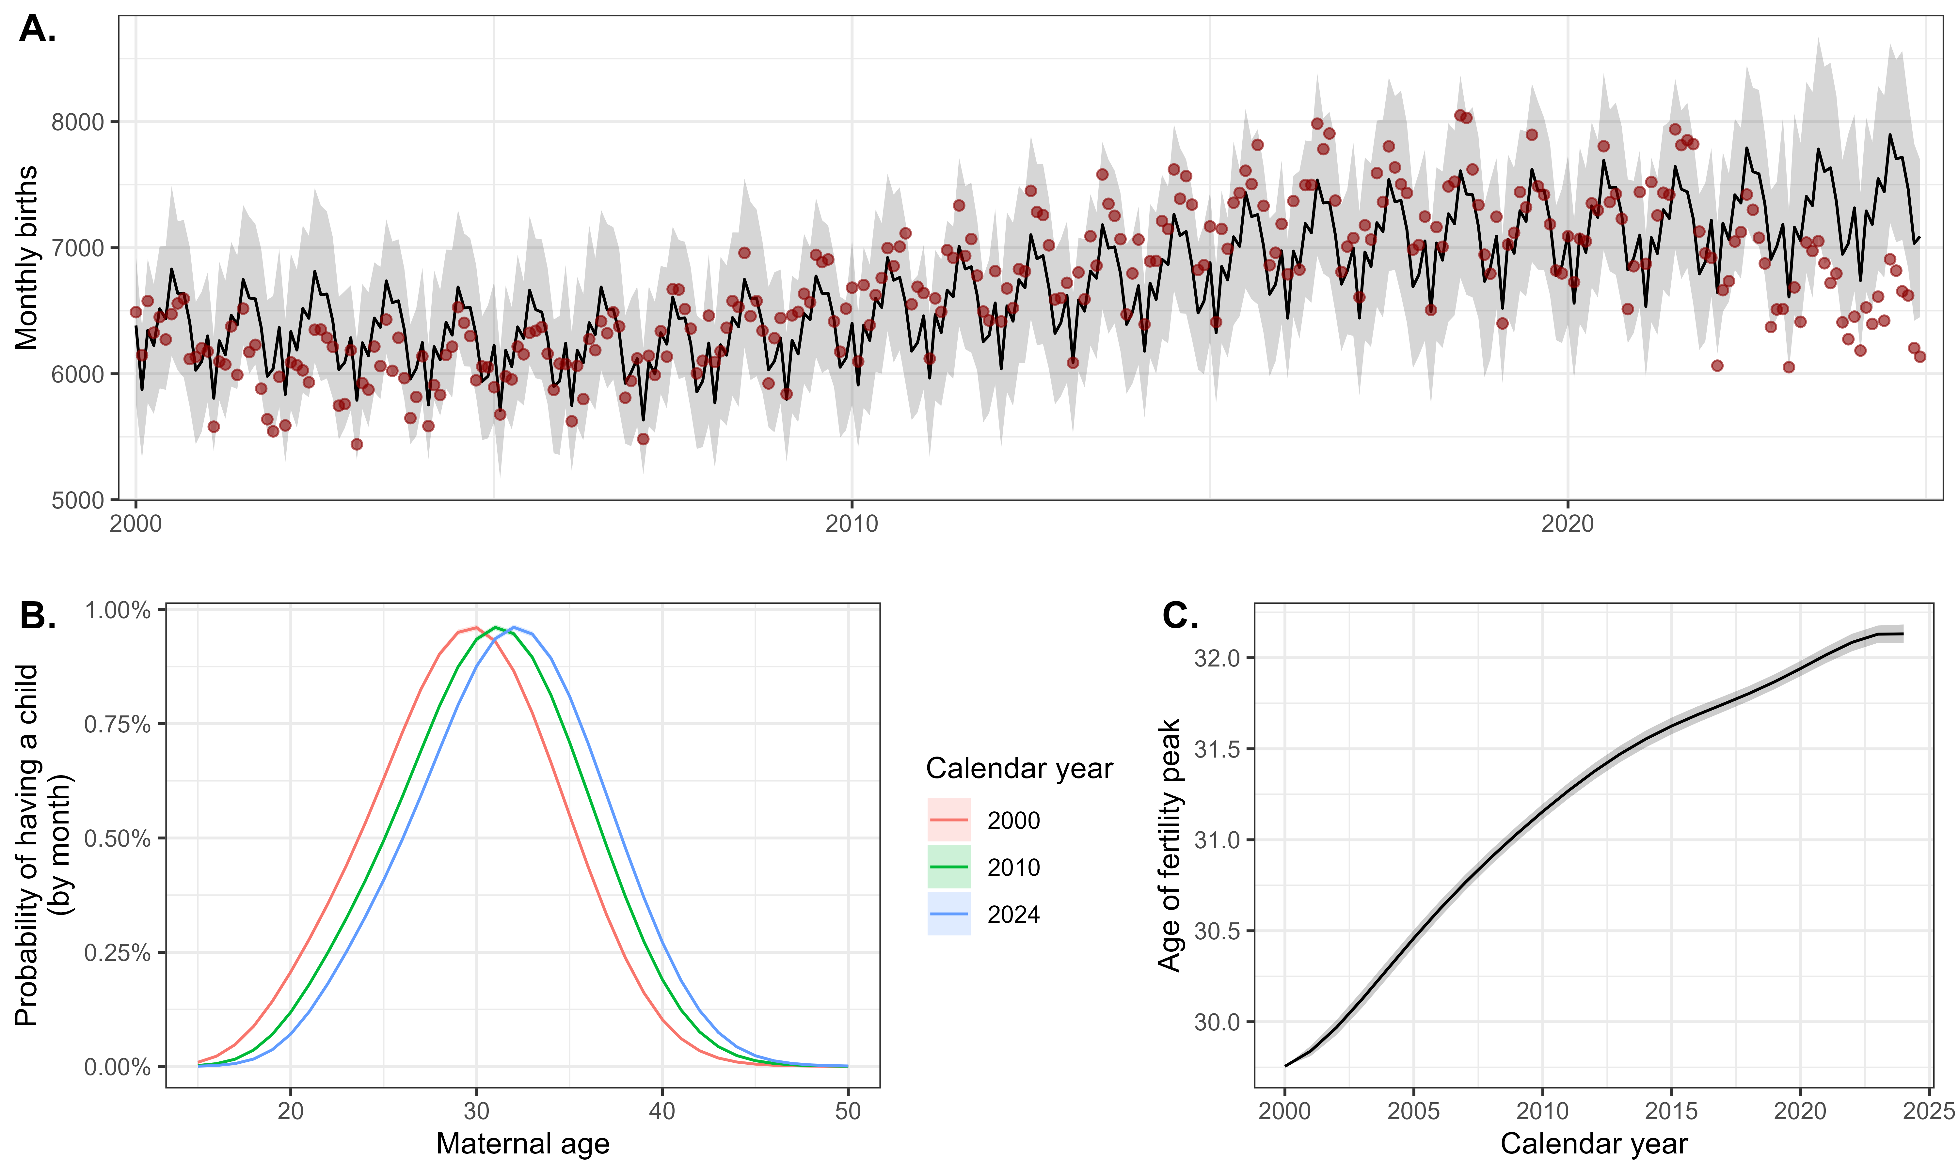
Fit
Goal: Assess the temporal and geographical variations in birth rate in Switzerland in 2000-2024 after accounting for
Change in population size and distribution
Delayed childbearing
Data:
Birth: individual-level with information about mother (age, municipality, citizenship, etc.)
Population of women by age and municipality over time
Model: Negative-Binomial distribution fitting the number of births by month and maternal age
Outcomes
Expected births: Number of births expected if fertility levels had remained constant over time.
Excess births: Observed births – Expected births
Extrapolated at different levels :
Nationally
Municipality-level
By subgroup (citizenship, parity)
Notes:
Goal: assess variation over time and region in birth rate
After account for two factors that directly impact birth
Women have children at an increasingly higher age
To do so, we use two data sources.
And we use a negative-binomial
Figure shows the model fit with observed in red and expected with the black line
And here, expected counts has a very specific meaning
While we keep fertility levels constant, the model still allows to shift to older ages to represent delayed childbearing.
Then we can naturally define excess births. And we will use this outcome in order to explore variations over time but also over space/municipality

Slide 7
Deficit in birth at the national level
National excess birth:
Steep decrease in the last years (except for 2021)
Excess births in 2021: effect of COVID-19 wave?
Excess birth by citizenship:
Marked differences over regions of the world
Swiss residents with lowest birth rate
Decreases in all regions
Notes:
Temporary increase in 2021
And when we investigate the monthly excess, we actually observe two peaks which happens
Suggest that it could be an indirect effect of COVID-19

Slide 8
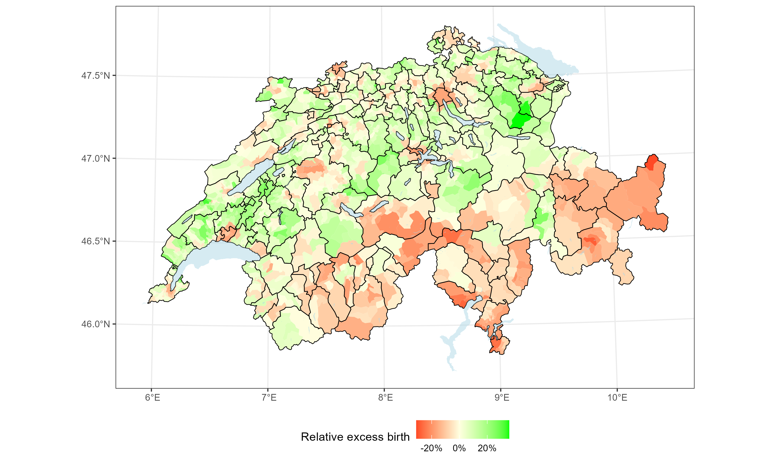
Deficit in birth by municipality
Relative excess birth in 2017-2024
Smoothed over neighboring municipalities
Deficit concentrated in cities
South regions (VS, TI, GR) also more affected
Notes:
Red means lower than expected

Slide 9
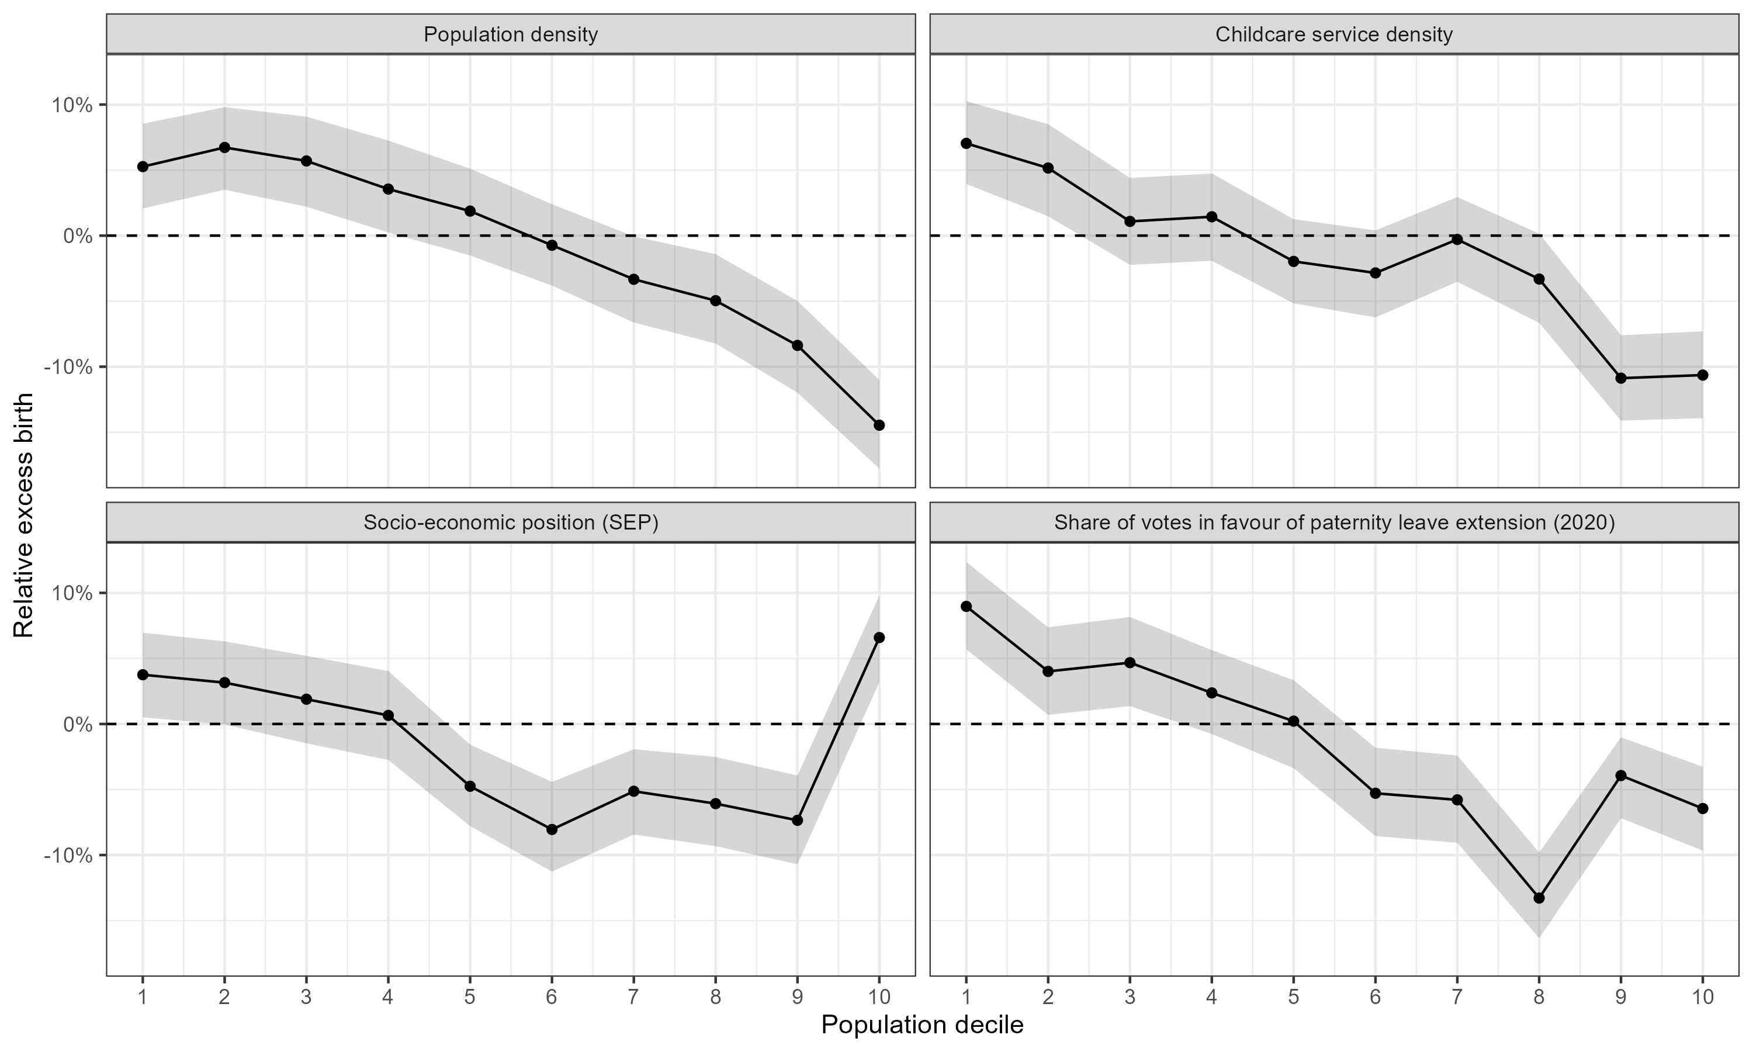
Results by explanatory variables (ecological level)
Explain this heterogeneity using municipality characteristics
Municipalities grouped into covariate deciles
Lower birth rates in more densely populated municipalities
Mixed results for other variables: no positive association with childcare services or support for parental aid policies
Notes:
Opinion about childcare policies
For each variable, we group municipalities in 10 variable deciles and calculate excess birth
For other variables, results are less clear and also more difficult to interpret because they could be confounded by population density (distort)

Slide 10
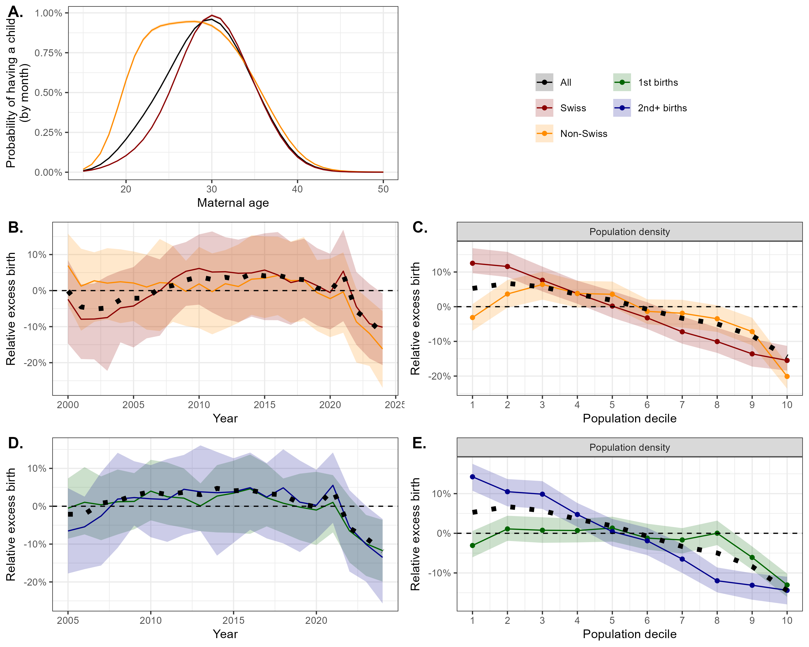
Results: subgroup analyses
Subgroups:
  Citizenship: Swiss vs non-Swiss residents
  Parity: first child vs 2nd+ children
Different fertility curves between citizenships (Panel A)
Decrease in all subgroups (Panels B and D)
Effect of population density more marked among Swiss residents and for 2nd+ births
Notes:
But what is common is the decrease
less apparent for the first child and mostly occurs from the second child

Slide 11
Comparison and explanations
Step 1: Update and expand BevNat analysis
Add 2023–24 BevNat data
Include ecological indicators (Swiss SEP, municipality typology)
Deepen subgroup analyses
Step 2: Explore triangulation with other data
Compare BevNat with other Swiss datasets to deepen and strengthen findings: USZ clinic data, CH hospital statistics, SHP, economic/voting data, FiVNat
Link data at municipal/district/MS region levels
Map available birth datasets and identify gaps/challenges
Step 3: Publication and funding
Co-author paper on trends
Develop framework for SNSF or similar funding
Notes:
We explored various ways of data triangulation, but soon realized that this was more challenging than we had anticipated.
Either the other datasets didn’t provide any additional variables, or their coverage wasn’t as good as we had expected, or their spatial resolution wasn’t high enough.
So, we ended up discovering more obstacles and gaps than anything else. But all of this will now be incorporated into Step 3: the larger grant application.

Slide 12
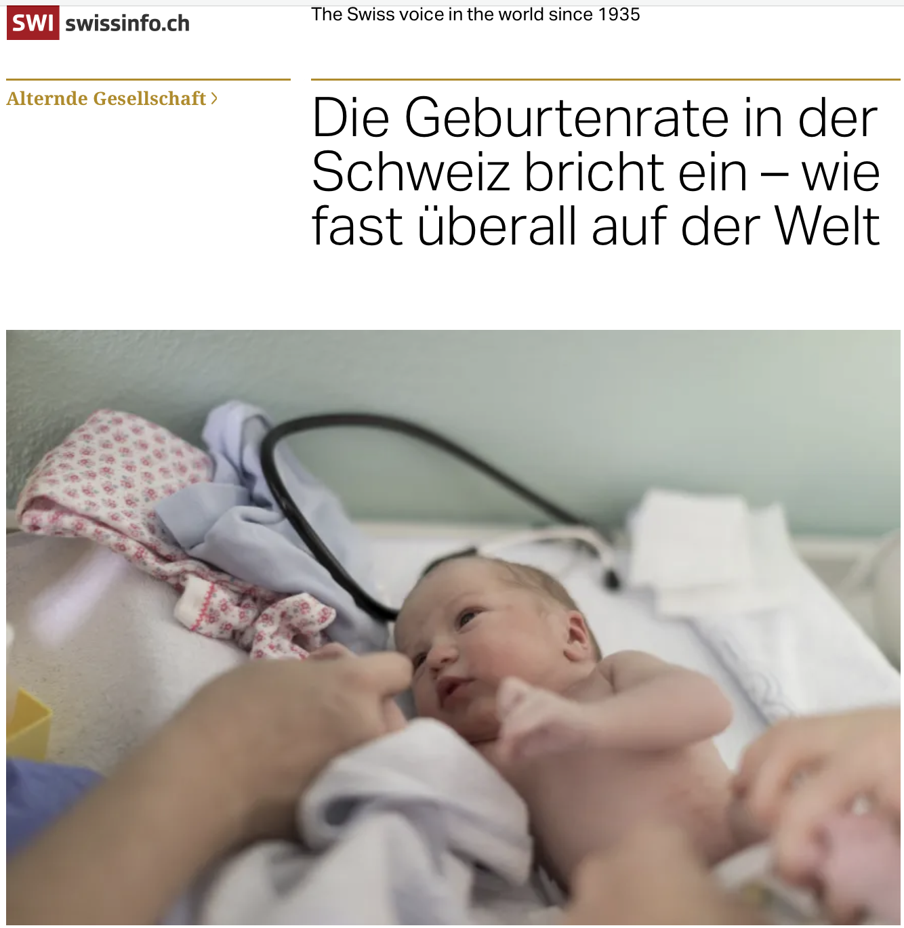
Background & motivation
Big picture
Declining birth rates have become a major focus in many regions worldwide
Some countries saw a temporary rise in births during the Covid-19 pandemic in 2021
However, many European countries continue to face a decline in birth rates (started before pandemic)
Contributing factors (still under discussion):
  Changing attitudes toward life and family
  Shifts in life planning decisions
  Uncertainty and perceptions among young people
  Distribution of contraceptives
  State pension provision (decoupling of children)
  Decline in biological fertility
  Birth strike: insufficient participation of men in housework
Relevance
The topic is expected to gain increasing attention (also from authorities)
Clinicians are already feeling the decline in practice

Slide 13
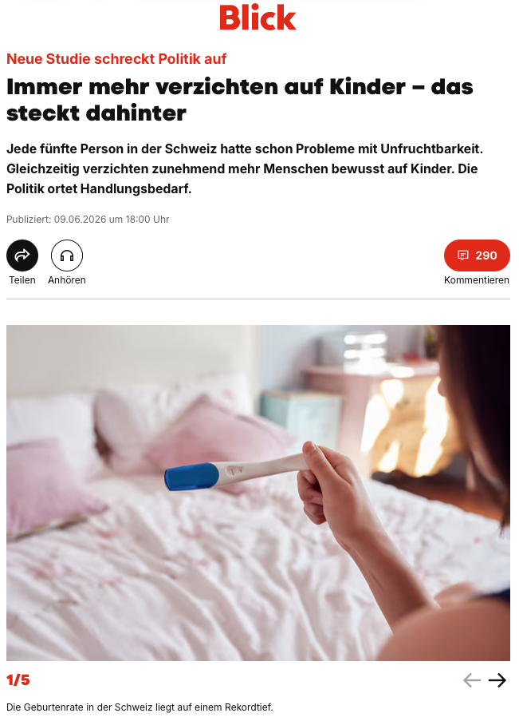
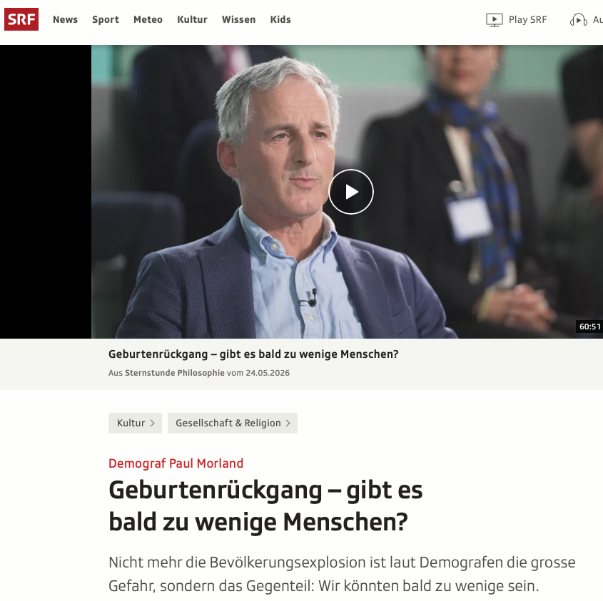
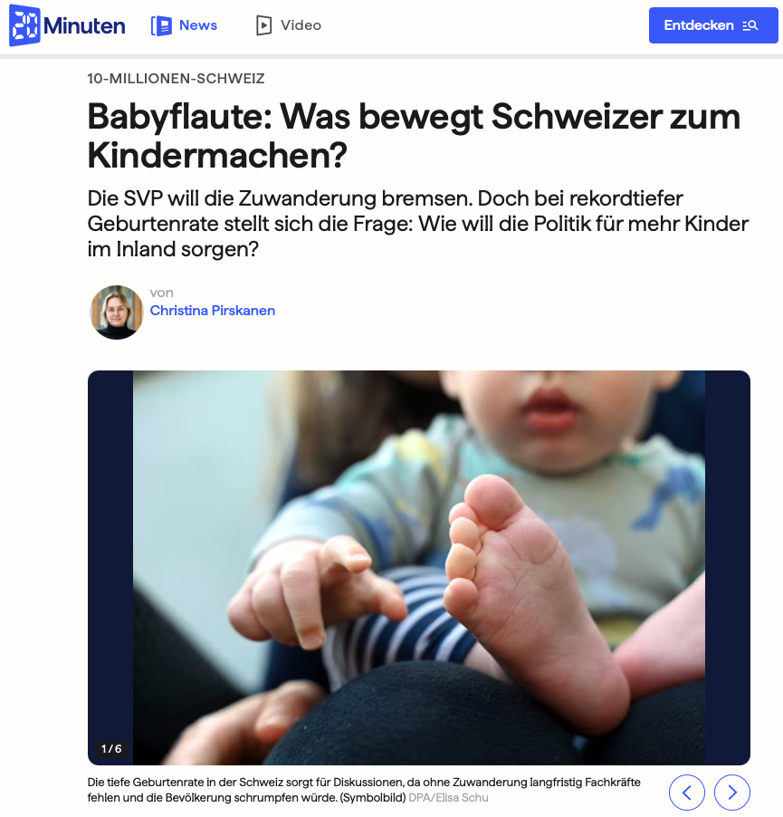
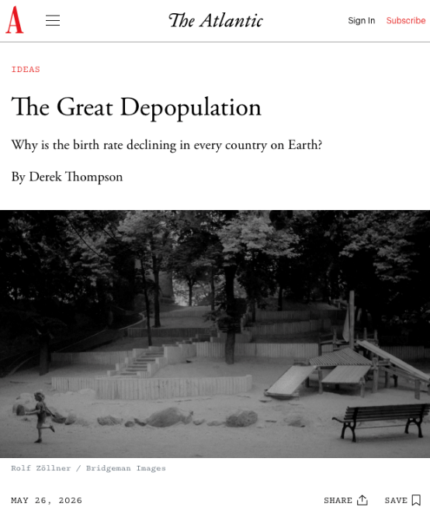
The topic remains relevant (media reports from the past few days)
Notes:
The topic remains highly relevant, as evidenced by these media reports from just the past few days,
and the discussion centers on understanding the reasons behind it, the political aspects, and what this means for the future.

